Slide 1
Cheap Chicago (formerly known as Take me away)
CS122 Project proposal
Computer Science with Applications 2
Hector Salvador and Carlos Grandet
March 10th, 2016

Slide 2

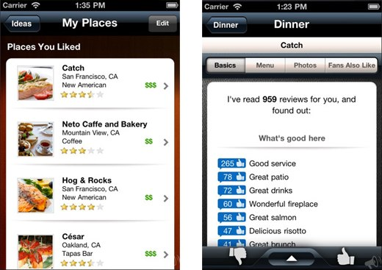
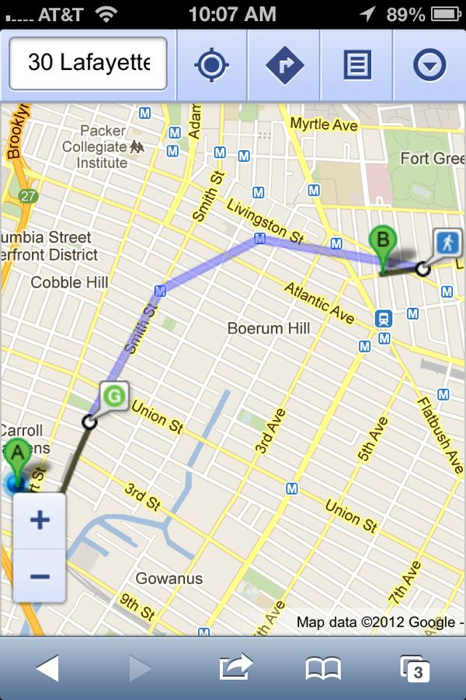
Goal
Develop a website suggesting :
Affordable places
Attractive and well-rated locations
With characteristics you like!
Personalized options
Suggests places
Maps destinations

Slide 3
How did we do it?
Getting the information
Scoring places
Visualizing results
Yelp: scraping and API
Individual ratings and comments were not available from the API
Scraping was convenient as we could “pre-filter” businesses by neighborhood, price, and type
Score based on:
Price, “$, $$” from Yelp
Ratings, weighted ratings according to the days passed since its posting
Distance, calculated from a “gravity” center of places
Attributes, matched from the key words checked on the website
Django interface
Return the three best-scored locations from the selected categories
Show suggested spots in a map using Google Static Maps API

Slide 4

Challenges and surprises
Scraping Yelp’s website took considerable amount of time:
Too long to create beautifulsoup objects
Some places had hundreds of reviews which took too long to read (>5 sec/page and every page had only 20 reviews)
We got banned. Twice.

Slide 5
Challenges and surprises
How to create a scoring?
Initially thought of clustering, but too complex to implement
Distance rating ended up being a deviation from the weighted average of the locations
Dropped the problem of getting from point A to B in shortest possible time

